Slide 1
Fundraising in the “New Normal” World Monday, November 16, 2020 2:45 – 3:45 Facilitator: Joseph April, Director of Development, Strawbery Banke Museum, NH Speaker: Marvin LeRoy, President & Founder, Institute for Philanthropic Excellence, NY

Slide 2
Itinerary
Introductions
The New Normal
If We Had Had A Crystal Ball….
Six Fundraising Strategies
Questions & Answers

Slide 3
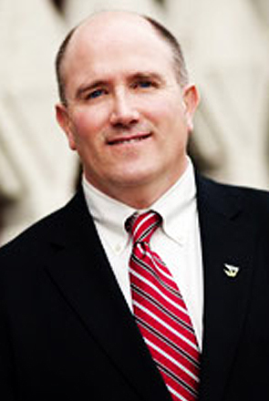
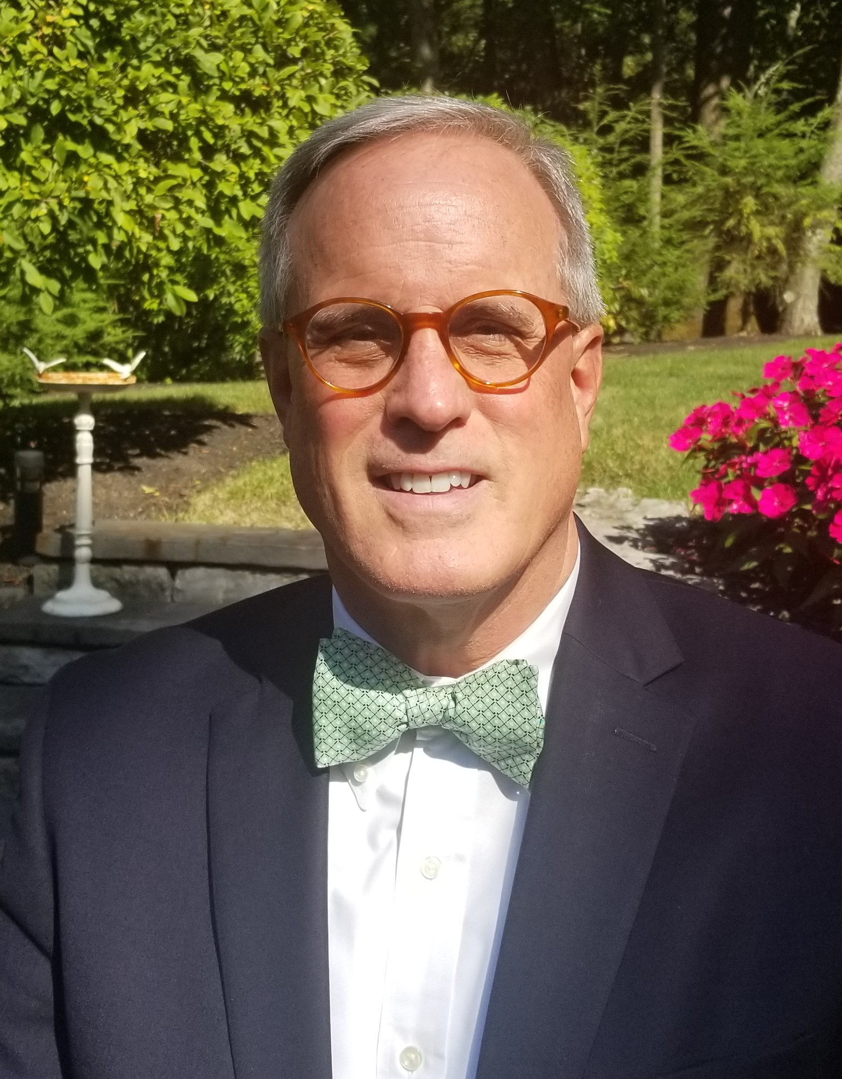
Introductions
Joe April
Director of Development
Strawbery Banke Museum, NH
Marv LeRoy
President & Founder
Institute for Philanthropic Excellence, NY

Slide 4
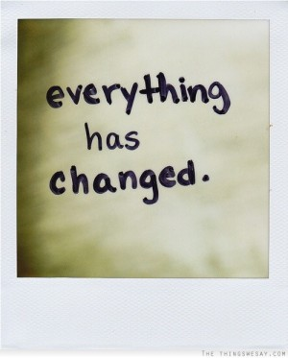
What’s gone up…
Unemployment
Virtuality
Social Advocacy
Online Giving
Online Wills
Point of Contact Giving
Philanthropy from Millennials
Interest in philanthropic ROI
Fundraising for Programs
Comprehensive Campaigns
What’s gone down…
Traffic
Restaurants
Greenhouse Gas
Bricks and Mortar Fundraising
…and then there is the stock market….
2/1/20
28,538
11/11/20
29,397

Slide 5
If We Had Had A Crystal Ball….
What All Non-Profits had Wished They Had Done….
…..Replenish & grow larger reserves
What All Non-Profits Have Learned….
…..The importance of rainy-day funds and endowments.

Slide 6
Six Fundraising Strategies
Continue to solicit key stakeholders.
Monetize existing activities – to raise unrestricted funds.
Start, revive or grow planned giving.
Engage in-house mission experts.
Find or expand creative sources of revenue.
Carefully consider conducting virtual events, auctions, galas etc…

Slide 7
Strategy 1: Continue To Solicit Key Stakeholders
They are your biggest champions.
Individual major wealth hasn’t changed.
Don’t need a lot of cultivation.
Stay in “campaign mode” with clearly defined fundraising goals and expectations.
Further grow relationships with individuals of greatest capacity and inclination.
If not already a part of your fundraising program, introduce multi-year pledge options.

Slide 8
Strategy 2: Monetize Existing Activities – To Raise Unrestricted Funds
Chunk out operational costs by functional area and drive donors to those amounts.
Makes unrestricted giving feel restricted.
Self identifies donor areas of interest for long term cultivation.
We seldom raise great amounts of charitable gifts aimlessly. Always have a menu of offerings for donors/prospects to gravitate to in their giving … and aligns with your targeted program and services plans
History Within Reach Program - Virtual
3D Remote Field Trips
Live Visits with Role-players
Live Visits with Experts
Hearth Cooking Workshop
Puddle Dock Packs
Home School Programs
Restricted
Technology
Materials
$60,000
Unrestricted
Staffing
$50,000

Slide 9
Strategy 3: Start, Revive Or Grow Planned Giving
Helps mid-level donors make larger gifts than they thought they ever could.
Cast a broad net --- you will get donors you didn’t even know were out there.
PG = Future Endowments.
Doesn’t need to be a zero-sum proposition. Be sure to include PG into overall gift solicitations to raise more comprehensive commitments.

Slide 10
Strategy 4: Engage In-House Mission Experts
Get your content experts to bring their expertise virtually.
Members and stakeholders miss your Museum --- bring it to them.
Boards of directors and trustees need to step up and become more engaged as ambassadors and advocates across the spectrum of resource development.
This is the perfect time to offer/expand more formal virtual exhibits and tours. These activities might also inspire more permanent offerings in a “teched-up” environment to engage younger and broader audiences long term.
Be sure to offer more technologically driven giving options for these audiences as well.
Membership Coffee Talks
Meet with Larry
People of the Dawnland
Getting Dressy: How To Wear Historic Clothing
Objects of Mourning
Keeping History Above Water
Oppression and Freedom: Slavery in 18th Century Portsmouth

Slide 11
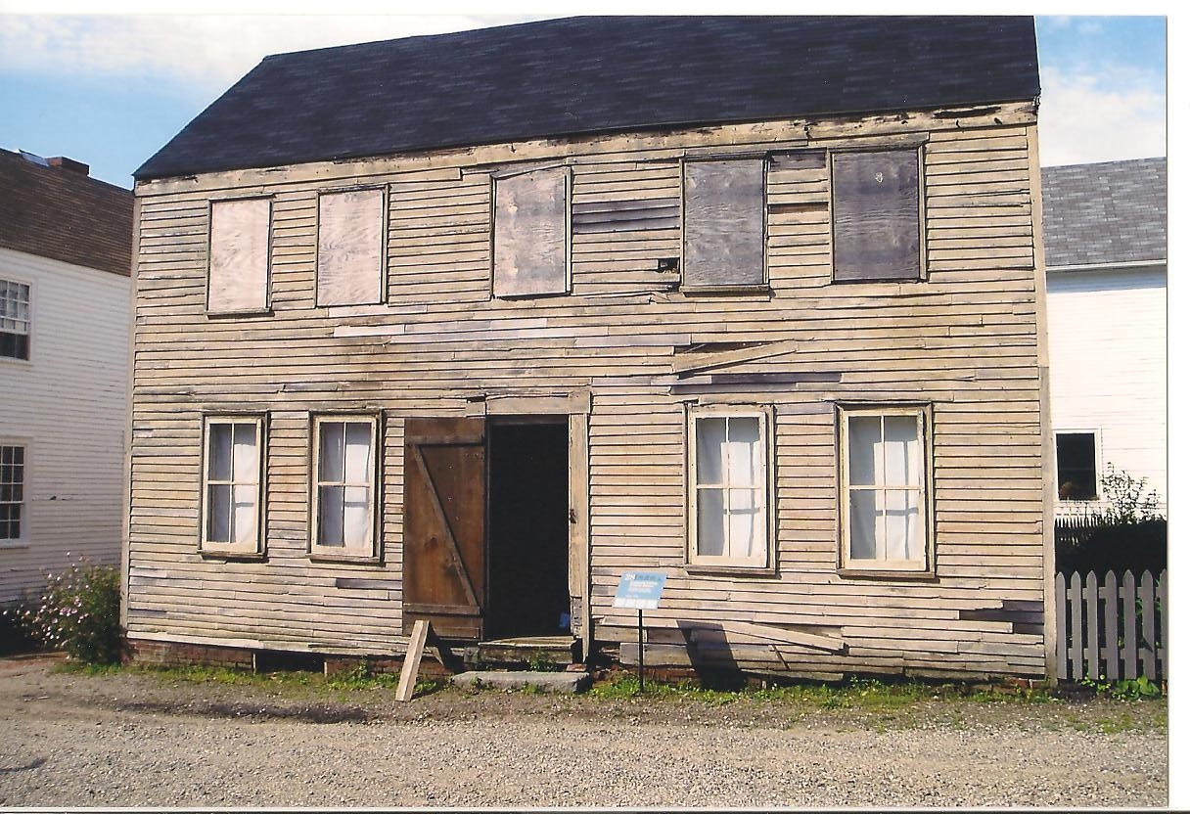
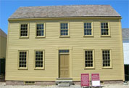
Strategy 5: Find Or Expand Creative Sources Of Revenue
Online merchandise.
Creative & safe site rentals.
Behind the scene virtual tours.
Related educational and recreational programs.
Candlelight Stroll Sponsor-A-Tree Program
$500,000/Year

Slide 12
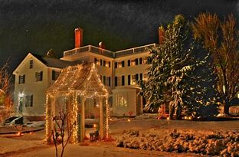
Strategy 6: Carefully Consider Conducting Virtual Events, Auctions, Galas, etc.
Donors are ‘virtual – saturated’.
Not everyone likes nor uses technology.
Lose the ease of networking … and relationship building.
Don’t simply try to replicate all aspects of a special event in an on-line format. Be very thoughtful about what works, and what works best, in these forums.
March Match-A-Thon
Live and Taped.
Stewardship
Solicitation
Cultivation
Pivot

Slide 13
Conclusion – What you can literally do tomorrow
Compile a top 100 stakeholder list and assign them to CEO/President, Volunteer Board Leadership, Board Members and Senior Staff to call and check in.
Meet with the CFO and chunk out operational costs into fundraising amounts. $100 = XX, $250 = YY, etc.
Create or expand a Legacy Giving Society.
Video 10-minute coffee talks within each area of your Museum.
Create on-line shopping opportunities.
Do an end of year chat with CEO & President.
Learn from our recent experiences and realities. Arts and cultural organizations are far too often driven in their resource development programs to Admission/Ticket Fees and Special Events. In this Pandemic period, we have learned that real life scenarios can play out to significantly interfere with these models. What can we do to soften the overall reliance on these funding streams, and what more can we do to grow financial reserves and endowments to position greater fiscal stability?

Slide 14
Thank You – Contact Information -- Questions
Joe April Marv LeRoy
(774) 261-3140 (518) 429-1829
japril@sbmuseum.org marv@moremission.com

