Slide 1
Joseph April, Director of Development,
Strawbery Banke Museum, NH
Marvin LeRoy, President & Founder,
Institute for Philanthropic Excellence, NY
Capital Campaigns 101
November 3, 2022
9:00 AM – 10:30 AM
Springfield, Massachusetts

Slide 2
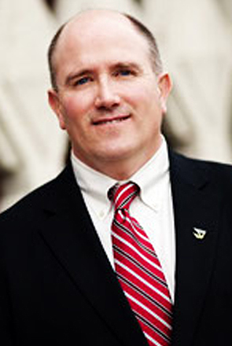
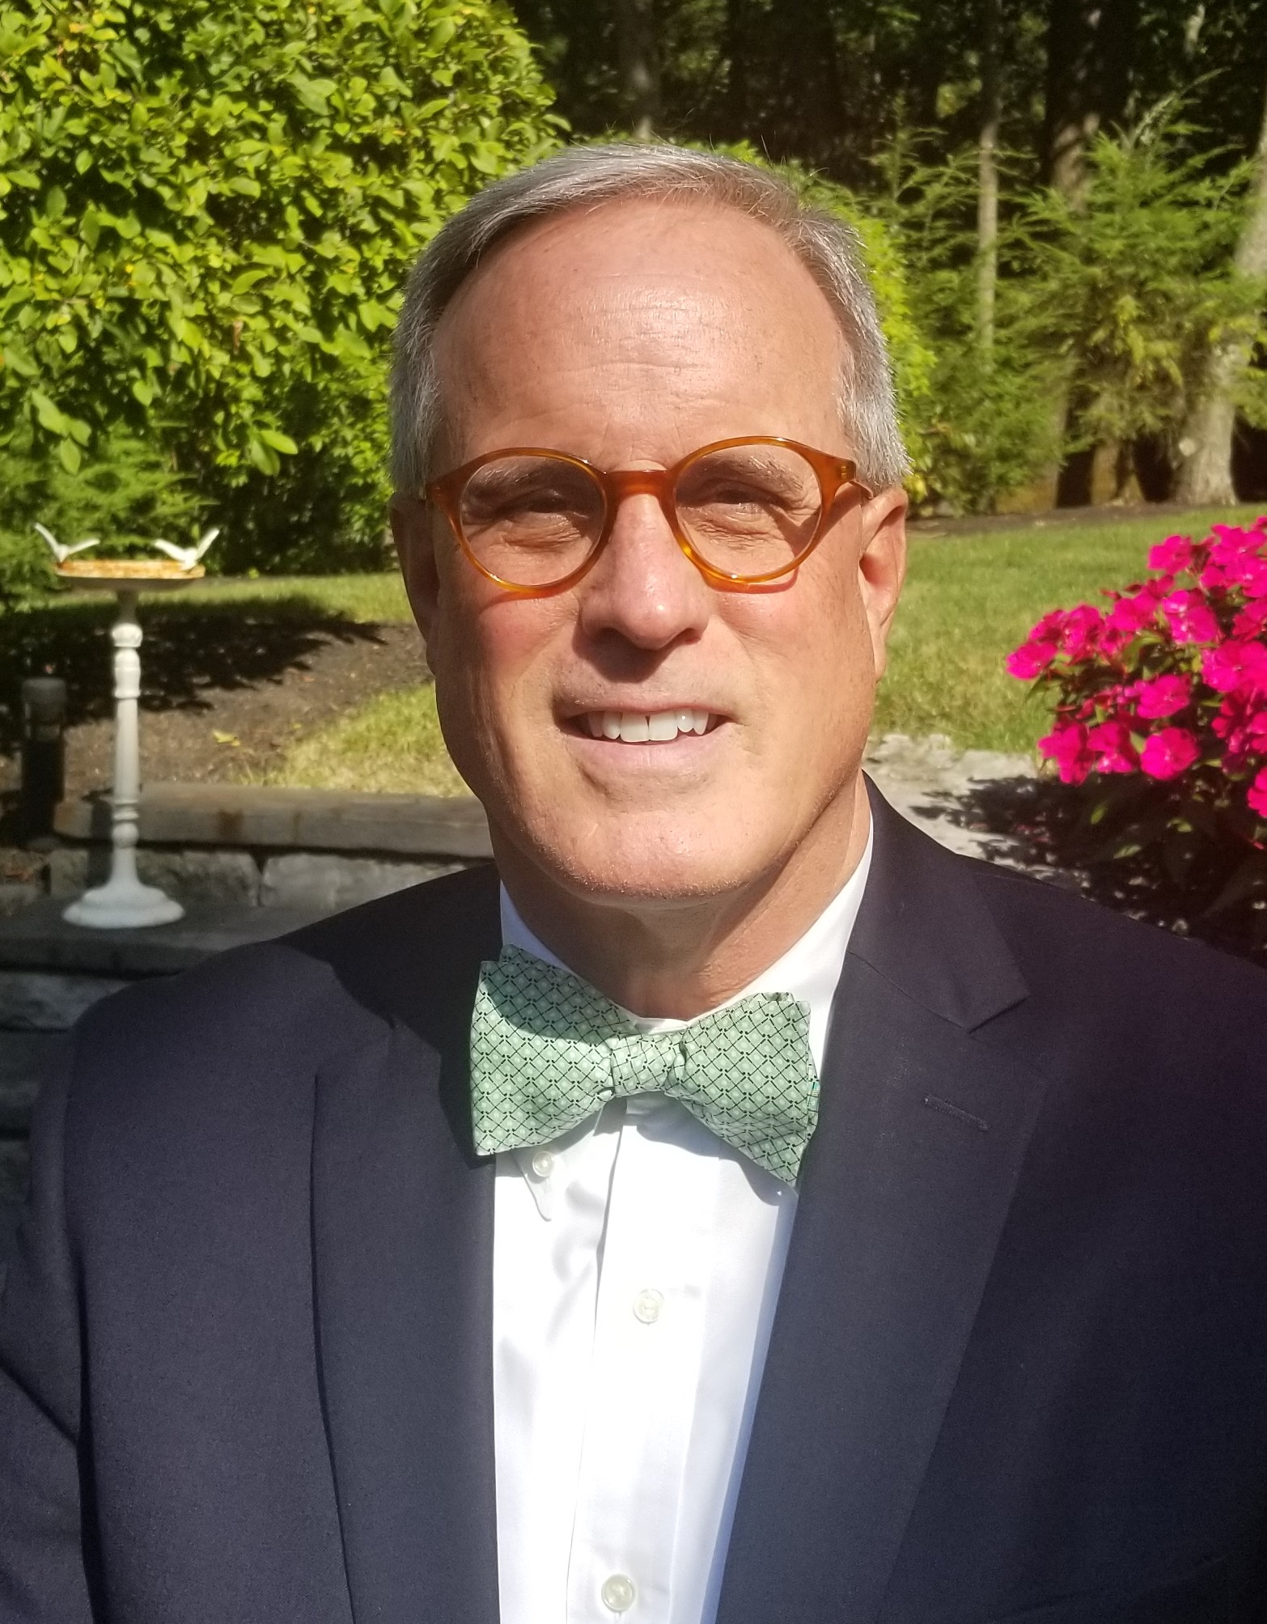
Introductions
Joe April
Director of Development
Strawbery Banke Museum, NH
Marv LeRoy
President & Founder
Institute for Philanthropic Excellence, NY

Slide 3
Desired Take-A-Ways
Capital Campaigns 101 Capital/Major Gift Fundraising campaigns can transform your museum from good to great. This session, led by two campaign veterans, will lay out simple steps to take that will raise significant support for ALL areas of your museum while also creating a culture of philanthropy with staff and volunteer leaders.

Slide 4
Overview
ONE Immutable Law of Fundraising!
What is a Capital Campaign?
Are You Ready – Internal Assessment
What Does the Outside World Think? Feasibility Study.
Let’s Do This – Six Campaign Fundamentals
Now What – Long Term Sustainability
Q & A

Slide 5
One Immutable Law of Fundraising
People give to People – Not Letters, Emails, Appeals….
The Right Person, making
The Right Ask, for
The Right Project, requesting
The Right Amount.

Slide 6
Data
Based on Penelope Burk’s current research about philanthropy in today’s competitive market…
42.5% of donors would give this year to a cause they had never supported before if asked to do so by a leadership volunteer or by someone they know personally
78.6% of donors plan to give the same or more this year to organizations they had previously supported if they get a personal appeal from a volunteer or someone they know
Penelope Burk, Philanthropy in a Turbulent Economy | www.burksblog.com

Slide 7
What is a Capital Campaign
What is a “Major Gift”
-- Large Enough to be Restricted to
Endowment
Capital
Program
History of What Campaigns are Called
  Capital Campaigns
  Major Gift Campaigns
  Mission Enhancement Campaigns
  Comprehensive

Slide 8
Are You Ready ?
Questions to Ask….
Are there Essential Needs that can not be met solely through non-philanthropic ways?
  …and are they sexy enough (Blast Furnace at Marian Manor)
Staff Leadership on the same page?
Volunteer Leadership on the same page?
Do you have the organizational infrastructure in place? Staff? Policies? Procedures?
Plan for Financial Stability

Slide 9
What Does the Outside World Think?
External Community
Museum
Value Proposition

Slide 10
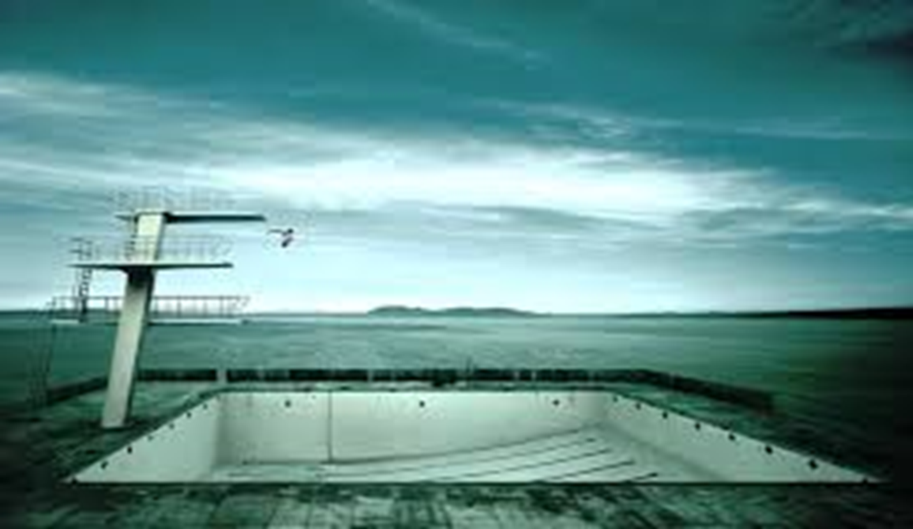
| Why do a Feasibility Study? |

Slide 11
| Feasibility Study Process |
Preparation + Interviews + Analysis = Feasibility Report
Preparation
Interviews
Analysis
Prospectus
Interviewee List
Questionnaire
Calendar
Confidential interviews with prospective Donors/Leaders
Interview Results
Recommendations
Campaign Goal
Strategies
Timeline
Interview Request Letter
Trend Analysis
Financial Potential
Leadership Potential
Challenges
Interviewee Perception
Plan Receptivity
Plan Improvements
Workshop
Internal Project Analysis
50-70 Interviews
In Person & Zoom
Investment Table

Slide 12
| Feasibility Study Roles |
Consultants
Outline & Manage the Process
Draft Prospectus & Study Documents
Staff
Articulate Mission, Goals and Vision.
Assist with Prospectus & Study Documents
Board
Share Personal Views on Mission & Vision
Identify Potential Study Participants
Conduct Interviews
Analyze Data, Write & Present Findings
Identify Study Participants, Schedule & Manage Interviews
Review and Participate in Study Review & Findings
Study Interviewee
Review and Participate in Study Review & Findings

Slide 13
| 3 Results of a Feasibility Study? |
Yes No Not Now
“NOT NOW” is OK…
…What Happened at Mt. No One Knows Who We Are Community College

Slide 14
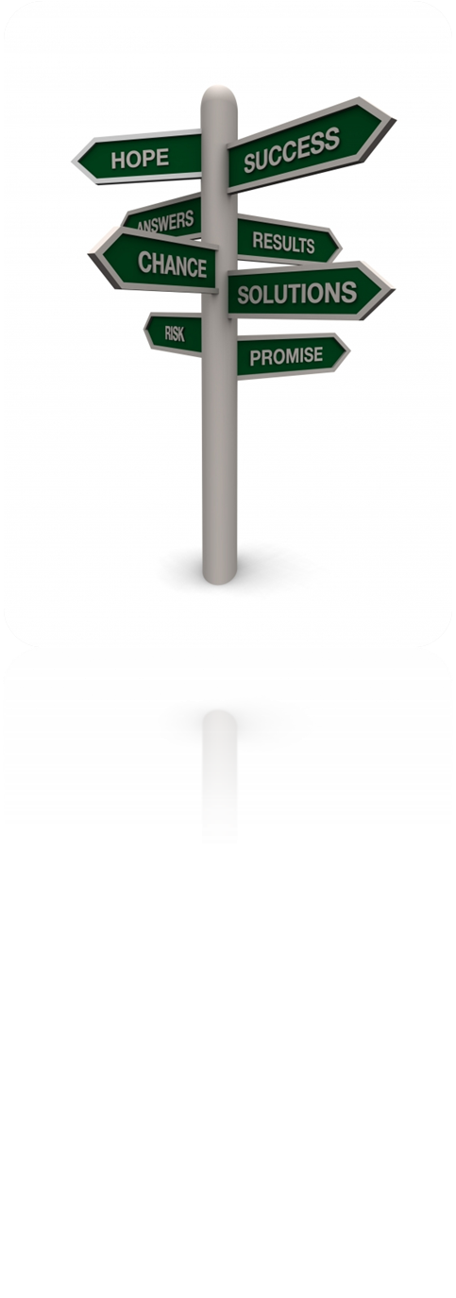
Six Components for Successful Campaigns
1
Essential Need
2
Compelling Case
3
Influential Leadership
4
Sufficient Prospects
5
Plan of Campaign
6
Sound Management

Slide 15
| Essential Need |
Can the Museum Operate without “it”?
Why is “it” Essential?
How was “It” Determined?
What is the ROI?
How will “It” be Sustained?

Slide 16
| Compelling Case |
Not We Want – Not What We Need etc… “Charity Mindset”
Focus on Outcomes.
Investors Vs Donors
Emotional and Practical
  Tell Stories
  Describe Impact
Multiple Mediums

Slide 17

Influential Leadership
Notes:
OK, now the meat and potatoes

Slide 18
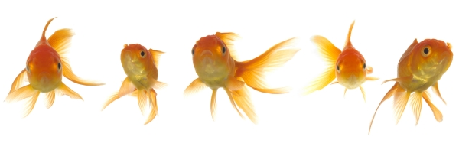
Basic Principles
Effective campaigns are volunteer-led and staff-managed
Each volunteer solicits no more than 5 qualified prospects

Slide 19
Sample Campaign Org Chart
Board
Campaign Steering Committee
Leadership Giving
Segmented Division (s)
Public Phase Division
Notes:
OK, now the meat and potatoes

Slide 20

A Major Gifts Campaign is an
Organization-Wide Responsibility
President?CEO is the chief campaign/institutional advancement officer
The campaign is under the direction of the Campaign Manager
A successful campaign requires involvement, cooperation and support of ALL the organization's family

Slide 21
The Role of the Campaign Manager
To administer, manage and facilitate the campaign process
  Plan
  Organize
  Motivate
  Evaluate
  Control
Quarterback
In essence, to provide sound management in carrying out the campaign

Slide 22
Role of the Consultant
Draft Campaign Plan
Training, coaching and counsel
Best practices
Increased efficiency
Keep things moving forward
Tap into areas of expertise
  Campaign
  Planned Gifts
  Grants
  Workforce
  Prospect research
Notes:
22

Slide 23
The Role of the President/CEO
Embodies the Vision & Provides Leadership
Inspires a Sense of Urgency
Gives at Least 50% of Time
Secures Largest Investments
Builds the “Team”
Is the Star Running Back

Slide 24
The Role of
Senior Leadership
To understand, appreciate and promote the campaign process
If requested to do so, to assist in cultivation, enlistment and motivation of volunteers and potential major donors
To attend most, if not all, major events involved with the campaign
ambassadors
friendraisers
examples

Slide 25
The Ongoing Role of the Board
To be
To be
To be
To be
To be
to the President/CEO and the Development Team
advisors
ambassadors
to the community
friendraisers
for the organization
examples
by personally investing in the organization
fundraisers
from private sources
"The key to successful leadership today is influence, not authority."
— Kenneth Blanchard

Slide 26
The Role of Campaign Steering Committee
To be examples by personally investing in the organization at levels commensurate with their ability
To provide leadership and oversight during the entire campaign
Review, edit, approve, monitor and adjust the Campaign Plan
Orchestrate the selection and enlistment process for top level prospects
Participate in high level asks

Slide 27
| Sufficient Prospects |

Slide 28
| Rating and Ranking Prospects|
B Level Prospects
A Level Prospects
Capac
I
ty
C Level Prospects
Inclination

Slide 29
| Capital Campaign: Quiet Phase |
DEVELOPMENT OF CAMPAIGN MATERIALS
Program refinement
PROSPECT EVALUATIONS
Prospective donor research
Prospect database
LEADERSHIP RECRUITMENT
Enlist influential leaders
Secure appropriate pacesetting pledges early in the campaign
Case statement
Campaign brochure
Outcomes-based ROI analylsis
Evaluations committee
Determine financial targets for all prospects
ID door openers
Match leaders to the right position
MAJOR PROSPECT SOLICITATIONS
Investor cultivation
Conduct 20-30 strategic solicitations
Leverage volunteers’ relationships & influence
Secure at least 75% of goal
Wealth screening

Slide 30
| Capital Campaign: Public Phase|
PUBLIC KICK-OFF EVENT
Announce & introduce leadership team
GENERAL SOLICITATIONS
Capitalize on Kickoff momentum
Announce attainment of 70% (or more) of goal
Present plans to prospective donors & media
Showcase endorsements from key leaders
Generate excitement & momentum
Make in-person solicitations to 75-100+ middle and lower division prospects
Conduct grassroots mass solicitation effort via letter, phone, social media
Follow up & finalize all commitments
Finish over goal, under budget, and on time
Write & present Wrap-Up Report

Slide 31
| Sound Management|
Stay Undaunted…Bitter Disappointments vs. Pleasant Surprises
Keep eyes on the outcomes
Pivot When Needed
Volunteer Fatigue
Celebrate

Slide 32
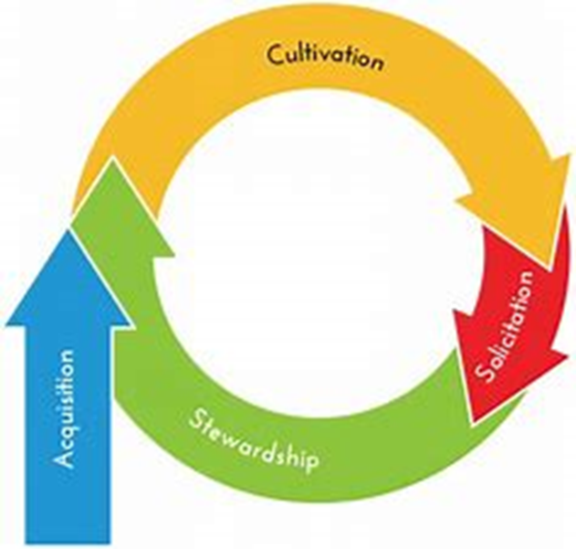


| Biggest Obstacle is Board Fear vs Reality|
The smallest part of the giving cycle is the solicitation.

Slide 33
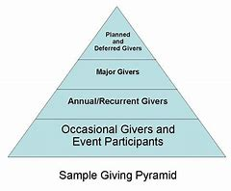
Building – Growing a Sustainable Program
Sustainable Giving Goes This Way

Slide 34

Thank You – Contact Information -- Questions
Joe April Marv LeRoy
(774) 261-3140 (518) 429-1829
japril@sbmuseum.org marv@moremission.com

